Slide 1
VHDL_02: More RTL Block Design
Topics
Using default statements for combinational processes
Three types of RTL blocks:
counters
shift-registers
finite state machines
UART- Receiver : requirements for design (Lab-2)
Design Partitioning (divide and conquer :o)

Slide 2
VHDL_02: More RTL Block Design
Examples
COUNT_DOWN.VHD
ALARM_LEVEL_DISPLAY_WO_DEFAULT.VHD
ALARM_LEVEL_DISPLAY.VHD
SHIFTREG_P2S.VHD
SYNC_N_EDGEDETECTOR.VHD
FSM_EXAMPLE.VHD
FSM_EXERCISE.VHD

Slide 3
VHDL_02: More RTL Block Design
Laboratory
Design of a UART receiver (UART-RX) with:
Baud rate: 31250 bits per second
Serial input via GPIO pin in extension header of the board
Display each received byte into two seven segment displays (as two hexadecimal characters)
Check for correct values of start-bit and stop-bit

Slide 4
Example: Alarm Level Display with IF-THEN-ELSE
Alarmstufe
Alarm w. Priority 1 (prio1)
red
orange
Alarm w. Priority 2 (prio2)
yellow
Alarm w. Priority 3 (prio3)
green
Notes:
In a system are several sources for an alarm.
Some alarms are more sever then others and get Priority 1
The indicator is supposed to ease th recognition of the situation several alarms come at the same time
E.g. if alarm prio 1 is active, the yellow lamp reports a minor problem, but if in additional an alram of priorit 1 is activated, the red lamp indicates a major problem

Slide 5
Describe a Truth Table with Don’t Care using IF-THEN-ELSE statements
Eingänge |  |  | Ausgänge
Prio1 | Prio2 | Prio3 | grün | gelb | orange | rot
1 | x | x | 0 | 0 | 0 | 1
0 | 1 | x | 0 | 0 | 1 | 0
0 | 0 | 1 | 0 | 1 | 0 | 0
0 | 0 | 0 | 1 | 0 | 0 | 0
Notes:
The priority example represents an incomplete truth table

Slide 6
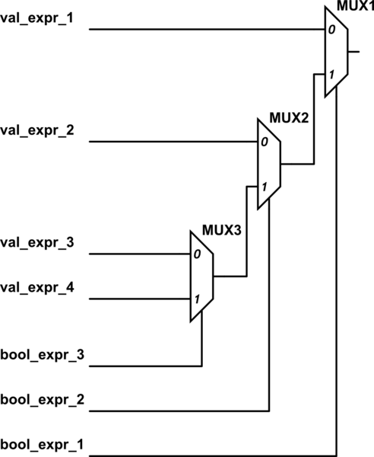
Priorisation with IF-THEN-ELSE
IF-THEN-ELSE describes
logic with priority
IF bool_expr_1 THEN
sig <= val_expr_1;
ELSIF bool_expr_2 THEN
sig <= val_expr_2;
ELSIF bool_expr_3 THEN
sig <= val_expr_3;
ELSE
sig <= val_expr_4;
END IF;

Slide 7
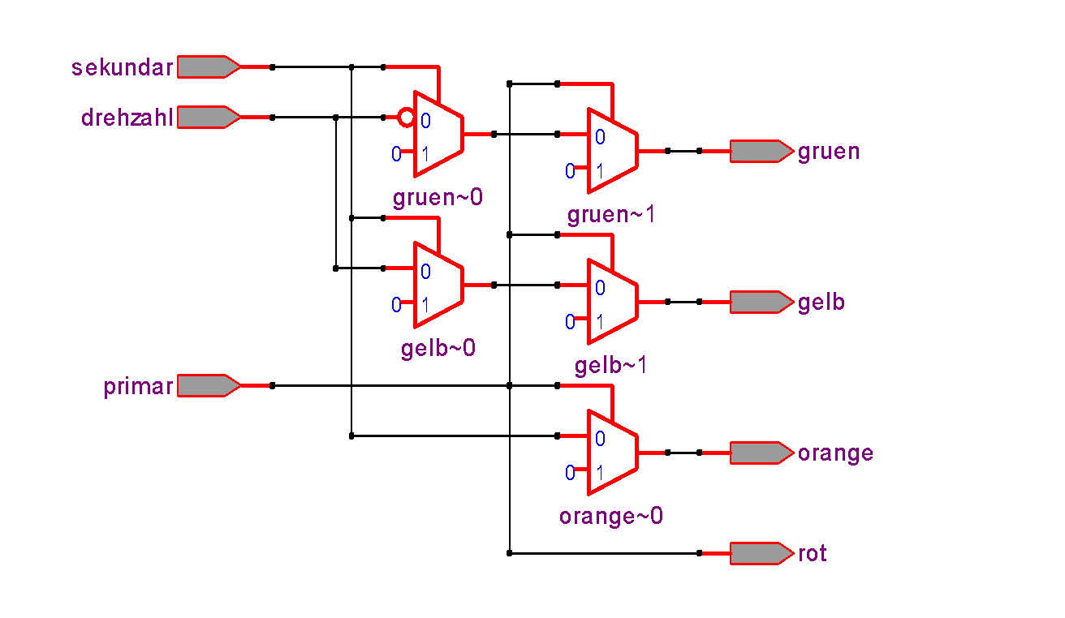
Synthesis output (RTL Viewer) with Quartus
prio2
prio3
prio1
Notes:
When synthesized, the IF-THEN-ELSE again is in the first synthesis step transformed to multiplexers.
The lines with higher priority appear closest to the output
As further down in the IF-THN-ELSE lines we go the inputs move away from the outputs. The prio3 signal has to pass through 2 levels ov multiplexers

Slide 8
Case Statement in Process
CASE <control input> IS WHEN <test> => {<sequential statements>}; [WHEN <test> => {<sequential statements>};] … [WHEN OTHERS => {<sequential statements>};]
END CASE;

Slide 9
Beispiel: 4 x 1 Multiplexer mit CASE
2
a
2
"00"
b
"01"
x
c
"10"
d
2
"11"
sel
CASE ist NICHT Priorisierend
ARCHITECTURE comb OF mux_beispiel IS BEGIN muxer: PROCESS(sel,a,b,c,d) BEGIN CASE sel IS WHEN "00" => x <= a; WHEN "01" => x <= b; WHEN "10" => x <= c; WHEN OTHERS => x <= d; END CASE; END PROCESS muxer; END comb;
Notes:
A CASE is one method in VHDL to describe combinatorial logic
Case is very similar to a truth table sel is the vector description of the Input of the truth table
Each entry of a line that begins with «WHEN» describes the output behavoiour of that trutj table
If a truth table can not be listed complete (in most cases it is impossible, since a signal is not just 1 or 0 but als o Z, x …) WHEN OTHERS covers all thos unlisted combinations. The compiler checks if all combinations are listed

Slide 10
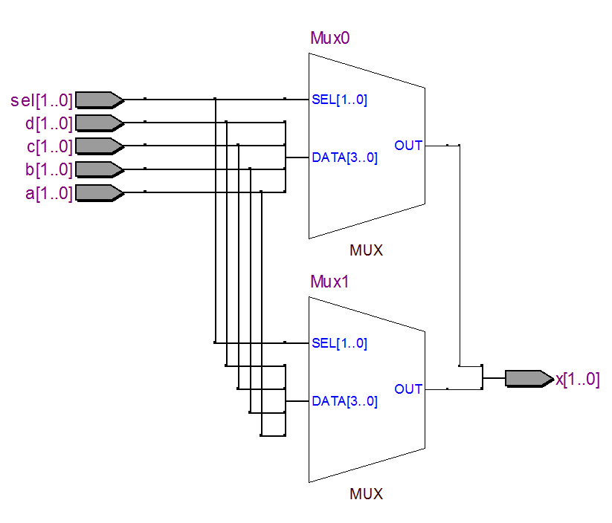
Multiplexer nach Synthese mit Quartus
(RTL Ansicht)
Erster Schritt:
Umwandlung in Multiplexer
Notes:
The transformation from text input to LCELLs happens in several steps
First step: The synthesizer transforms the CASE statement in Multiplexers

Slide 11
Examples: Counters

Slide 12
1) Modulo Counter
+
Q
n
n
n
= number of FFs
+1
clock
Overflow when counting up:
Underflow when counting down:
0xf | 1111
+0x1 | 0001
 | 10000
0x0 | 0000
-0x1 | 1111
 | 1111
Carry bit (ignored / hardware limitation!)
‹#›

Slide 13
2) What is the behaviour of this counter?
n
+1
0
D
cnt
1
Q
+
n
n
= number of FFs
enable
!Q
Takt
clk
enable
cnt
D
cnt
cnt + 1
cnt + 2
‹#›

Slide 14
3) Counter with Load
n
+1
1
D
0
Q
+
n
n
= number of FFs
n
!Q
load_value
load
Takt
clk
load
cnt
D
cnt n
cnt n+1
cnt n+2
load_value
l_value + 1
l_value + 2
l_value + 3
l_value
‹#›

Slide 15
4) Count-down with automatic Reload
n
-1
1
0
Q
+
n
n
= Anzahl der FFs
n
!Q
„9"
Dekoder für 0
zero
Takt
clk
zero
cnt
2
1
0
9
8
‹#›

Slide 16
5) Counter with Load and Enable
n
+1
1
0
0
1
n
Q
+
n
n
n
!Q
load_value
load
enable
Takt
Welcher Eingang hat Priorität, load oder enable?
‹#›

Slide 17
Three Basic RTL Blocks: - counters - shiftregisters - finite state machines (FSM)

Slide 18
RTL Basic Structure for Counters, Schiftregisters and State-Machines
n
D Q
S
D Q
in_sig
clock
reset_n
next_reg
n
R
reg
out_sig
The RTL basic structure of these three blocks is always the same!
Adapt the signal naming to make clear, which block is implemented
Obs.: here we consider a Moore FSM. Which difference do you expect for a Mealy machine?

Slide 19
Counter
n
D Q
S
D Q
next_count
n
R
count
clock
reset_n
out_sig

Slide 20
Shiftregister : example (1/2)
n
D Q
S
D Q
n
R
shift_lsb
serial_in
clock
reset_n
next_shiftreg
shiftreg
out_sig
LIBRARY ieee;
USE ieee.std_logic_1164.all; USE ieee.numeric_std.all;
ENTITY schieberegister IS PORT( clk,reset_n : IN std_logic;
shift_lsb : IN std_logic;
serial_in : IN std_logic; out_sig : OUT std_logic_vector(3 downto 0) ); END schieberegister;

Slide 21
Shiftregister : example (2/2)
ARCHITECTURE rtl OF schieberegister IS
SIGNAL shiftreg : std_logic_vector(3 downto 0); SIGNAL next_shiftreg : std_logic_vector(3 downto 0);
BEGIN logik : PROCESS (shiftreg, shift_lsb, serial_in) BEGIN IF shift_lsb = '1' THEN next_shiftreg <= serial_in & shiftreg(3 downto 1); ELSE next_shiftreg <= shiftreg(2 downto 0) & serial_in; END IF; END PROCESS logik;
flip_flops : PROCESS (clk, reset_n)
BEGIN IF reset_n = '0' THEN shiftreg <= (OTHERS => '0');
ELSIF rising_edge(clk) THEN shiftreg <= next_shiftreg; END IF; END PROCESS flip_flops;
… -- Output Zuweisung …
END ARCHITECTURE rtl;

Slide 22
Applications of Shiftregisters
PC serial interface or USB interface
Serial data input / parallel data output (parallel-serial conversion)
Parallel data input / serial data output, (serial-parallel conversion
Serial data input / serial data output)
Fast counter with few components
Generation of clock frequencies with different phase
Dividing / multiplying
Generation of pseudorandom sequences

Slide 23
Basic Structure of Shiftregister
Example with shift direction from LSB towards MSB
LSB
MSB
Q0
Q1
Q2
Q3
FF0
FF1
FF2
FF3
IN
D1
D2
D3
D
Q
D
Q
D
Q
D
Q
!Q
!Q
!Q
!Q
CLK
Notes:
What happens with this circuit, when all FF are Q=0 after reset , signal In=1 an a rising edge is applied to CLK? Will all FF Q0 - Q3 switch at the same CLK edge to 1 or only Q0 = 1 and the reset stays 0. If the second case applies, why?
The second case applies, because there is a delay from CLK until Q changes. Q0 remains 0 for a while, during the rising edge of CLK is applies at the CLK input of FF2 and such FF2 stays low.
Only one CLK edge later, also Q1 becomes high. The same repeats for Q2 and Q3.
The one is «shifted» from FF to FF, that is why we call this a shift register
It is importand to note that how the Shift register is shown here, the MSB is contrary to the usual drawings, on the right and LSB on the left. This is because the D input of FF are mostly on the left side of the FF and we read from left to right.

Slide 24
IEC Symbol for Shiftregister
SRG4
CLK
C1/
IN
Q0
Q1
Q2
Q3
Q0
Q1
Q2
Q3
FF1
FF2
FF3
FF4
IN
D1
D2
D3
D
Q
D
Q
D
Q
D
Q
!Q
!Q
!Q
!Q
CLK

Slide 25
Parallel to Seriell Conversion (and vice versa)
Parallel | Serial
MSB
LSB
Q0
LSB
1 | 1 | 0 | 0
Q1
Q2
Clock
MSB
Q3
Data
Example:
Printer
Example:
RS232 (UART)
USB
Microprocessorbus (32/64 bit)
Memory IC’s
Notes:
On a Parallel Data transfer, the Nibble or Byte that needs to be transferred consists of paralle birs eg. Q0-Q3
On a Serial Data transfer, the Data are transfered sequentially on after another, often accompanied by a clock

Slide 26
Parallel to Serial Converter
Example for shift towards LSB
D3
MSB
D2
D1
D0
LSB
Load
FF3
FF2
FF1
FF0
1
Q3
1
Q2
1
Q1
1
OUT
D
Q
D
Q
D
Q
D
Q
0
0
0
0
Q0
!Q
!Q
!Q
!Q
CLK
Notes:
The input of D-FF are connected to Multiplexers. With the Multiplexer one can choose whether the D Input of a FF is connected to the Q output of the previous FF or (shift Register Mode), or a direct paralle inpuz D0-D3

Slide 27
Universal Shiftregister 74F194 (only representing 3 bits)
S1 | S0 | Function
0 | 0 | Freeze
0 | 1 | Shift to MSB
1 | 0 | Shift to LSB
1 | 1 | Load
D0
D1
D2
S0
S1
FF2
FF2
00
FF1
00
00
11
11
11
D
Q
D
Q
D
Q
01
01
01
DSR
10
10
10
!Q
!Q
!Q
CP
Q0
Q1
DSL
Q2

Slide 28
Linear Shiftregister
SRG4
CLK
C1/
D0
Q0
Q1
Q2
Q3
=1
Notes:
The following example is a so called «linear shift register» built from a 4-bit shift register. In the 4-bit example, the last MSB of the shift register are xored and fed back to the shift register input.
Linear shift registers are possible with more than 4-bits, but the feed back logic is different.

Slide 29
State Diagram of linear Shiftregister
8
12
14
4
10
13
0
9
6
15
2
5
11
1
3
7
Maximale Length of Sequence = 2^{n} - 1
Notes:
The sequenz of a linear shift register is random considerung the values the 4-bits represent
If the Q outputs of the linear shift register would be connected to a D/A convertre, the output would be white noise
Of course the randomnes repeats after 2n-1 states

Slide 30
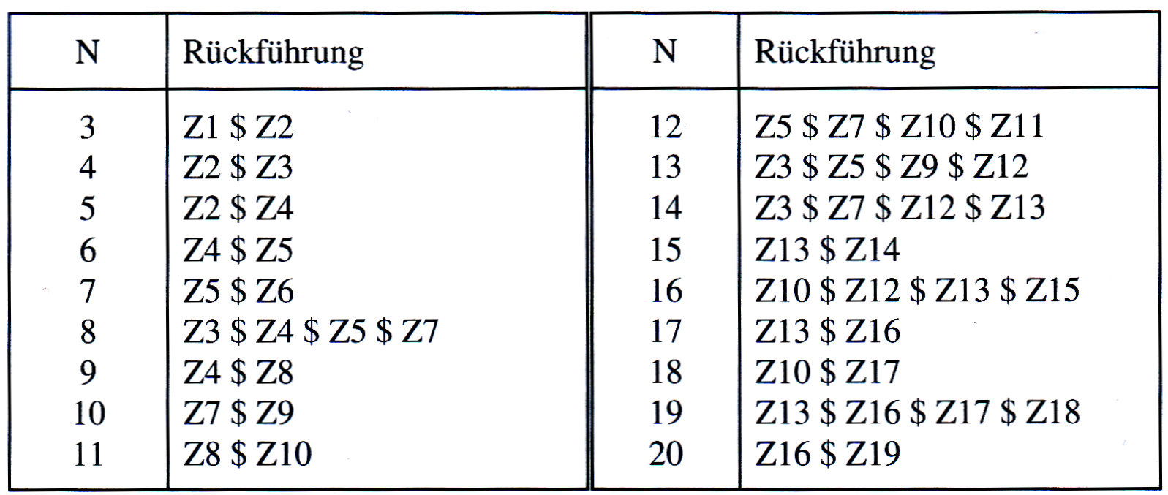
Generic Equations for linear Shiftregisters
Notes:
Is a table how linear Shift Registers can be built from 3 to 20 bits.

Slide 31
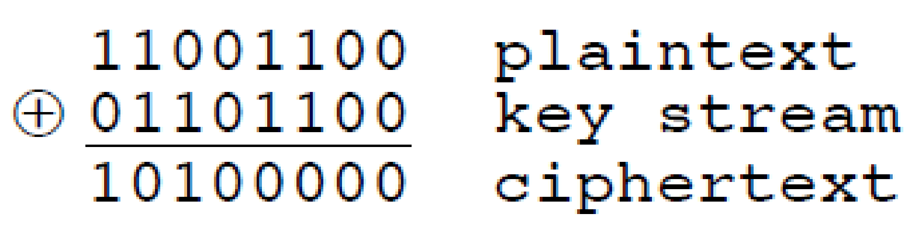
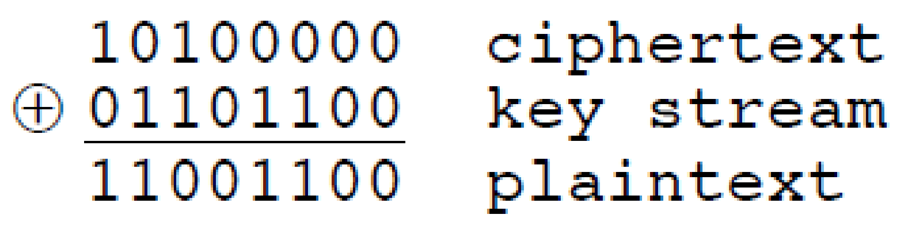
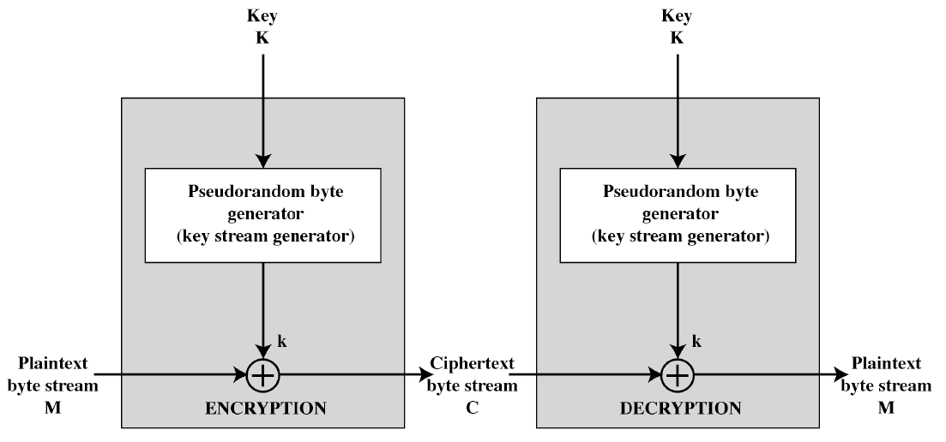
Application Example of linear Shiftregister: Pseudo Random Generator (PRG) to cipher a bitstream
Encryption Decryption
Quelle: THE RC4 STREAM ENCRYPTIION ALGORITHM _ William Stallings
Notes:
The following example is a so called «linear shift register» built from a 4-bit shift register. In the 4-bit example, the last MSB of the shift register are xored and fed back to the shift register input.
Linear shift registers are possible with more than 4-bits, but the feed back logic is different.

Slide 32
State-Machine : example (1/2)
n
D Q
S
D Q
n
R
mode_a
clock
reset_n
next_state
state
out_sig
LIBRARY ieee;
USE ieee.std_logic_1164.all;
ENTITY automat IS PORT( clk,reset_n : IN std_logic;
mode_a : IN std_logic;
out_sig : OUT std_logic_vector(3 downto 0) ); END automat;

Slide 33
State-Machine : example (2/2)
ARCHITECTURE rtl OF automat IS -- Typ declaration (enumerated type) fuer
TYPE fsm_states IS (idle, load_a, load_b, enable, wait_cnt);
SIGNAL state : fsm_states; SIGNAL next_state : fsm_states;
Obs:
With the type declaration the state encoding is not explicitly defined
The Synthesizer-Tool (Quartus) can select and optimise the state encoding to reduce the combinational logic.
In case you need to define the state encoding, do it by defining constants (but in most cases not)

Slide 34
Applications of State Machines (automaton)
Control functions in digital systems
Input-related sequential control
Control of a bus interface
Direct memory access in the microprocessor
Command pipeline in the microprocessor
Automaton = Finite State Machine (FSM)
Notes:
Finite state machines are «intelligent» controllers
They are very similar to counters. The simplest form is a counter which direction can be controlled by an external signal
FSMs are active Circuits and the engines which drive Bus Interfaces
A DMA is a circuit which actively reads data from one address range in a system and transfers it to another address range in the system, a FSM is the engine of a DMA

Slide 35
The Moore FSM RTL Diagramm
Z_{t}
A_{t} = μ (Z_{t})
Z_{t+1} = δ (Z_{t}, E_{t})
Q
Output- Logic
n
Drive Logic
n
n = number der FFs
μ
E_{t}
m
δ
!Q
clock
E_{t} = Input vector
Z_{t} = State vector at current time
Z_{t+1} = State vector after next clock edge
Notes:
The logic in front of the memory is called «Ansteuerlogic» becuase it calculates the next state out of the current state
In moost cases there is not only one controll signal, but several, the control signals are called «Eingangsvector» E. Signal bundles are often called Vectors
Z is the actual state or «Zustandsvector» at actual Time

Slide 36
The Moore FSM
Bubble Diagram (State Diagram)
transition
condition 1
State 1 /
000
State 2 /
001
transition
condition 2

Slide 37
Example: Sequence/Pattern Recognition
Recognise the following sequence of the input signal e_in (2 bits wide): „01/11/10“
Once the sequence is recognised the FSM generates an output pulse q_out with the width of one clock period
clk
e1_in e0_in
11
01
11
10
11
01
00
00
q_out
Draw the RTL diagram of the FSM?
Draw the bubble diagram of the FSM?

Slide 38
Example: Sequence/Pattern Recognition
Moore FSM
2
state
e1_in
D
Q
q_out
Drive- logic
next state
e0_in
!Q
reset
clk
clocked Process
Output Logic
Drive Logic

Slide 39
Example: Sequence/Pattern Recognition
Bubble Diagram
Inputs e1_in e0_in
00/11/10
01
01
Z1
Z0
01
00
00/10
11
00/11/10
01
01
11/00
Z3
Z2
10
11
10

Slide 40
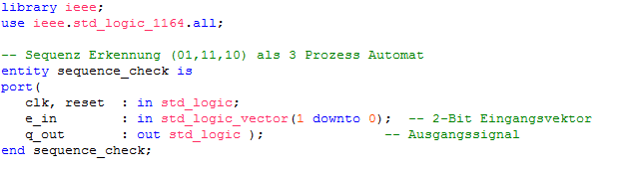
Example: Sequence/Pattern Recognition
VHDL Code - Entity

Slide 41
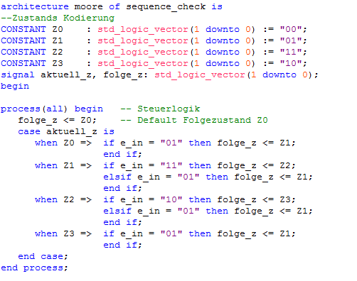
Example: Sequence/Pattern Recognition
VHDL Code architecture : drive logic

Slide 42
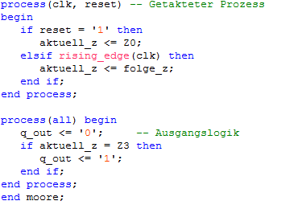
Example: Sequence/Pattern Recognition
VHDL Code architecture: flip-flops and output comb-logic

Slide 43
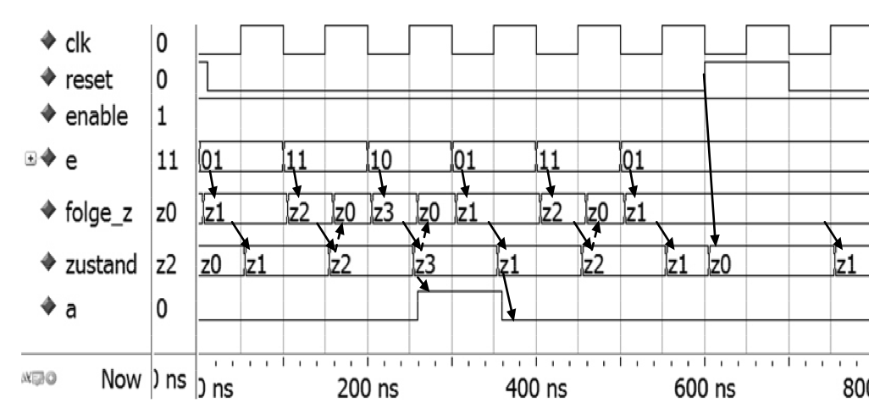
BeExample: Sequence/Pattern Recognition
Simulated Timing Diagram
next_state
state
q_out
Source: Lehrbuch Digitaltechnik : eine Einführung mit VHDL / Reichardt

Slide 44
Example: Sequence/Pattern Recognition
Is there a short-cut (more compact design version)?
Inputs e1_in e0_in
00/11/10
01
01
Z1
Z0
01
00
00/10
11
01
01
00/11/10
11/00/10
Z3
Z2
10
11
10
Set output during transition, once e_in = „10“ is detected

Slide 45
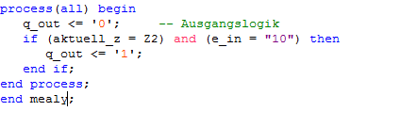
Example: Sequence/Pattern Recognition
VHDL Code of Short-Cut
Variation 1: Moore-FSM
Output depends
only on state (FFs output only)
Variation 2: Mealy-FSM depends additionally on inputs, e.g. e_in

Slide 46
Example: Sequence/Pattern Recognition
Mealy FSM: outputs also depends directly on input signals
2
2
state
e1_in
.
D
Q
q_out
Drive- logik
next state
e0_in
!Q
reset
clk
clocked Process
Output Logic
Drive Logic

Slide 47
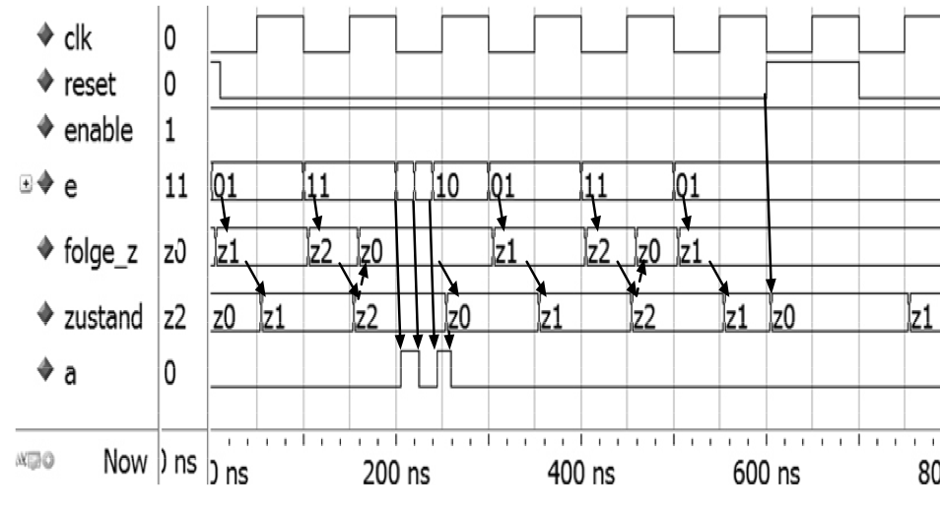
Example: Sequence/Pattern Recognition
Simulated Timing Diagram with Short-Cut (Mealy)
Dangerous: can produce glitches
folge_z
aktuell_z
q_out
Source: Lehrbuch Digitaltechnik : eine Einführung mit VHDL / Reichardt

Slide 48
UART Serial Protocol Universal Asynchronous Receiver-Transmitter

Slide 49
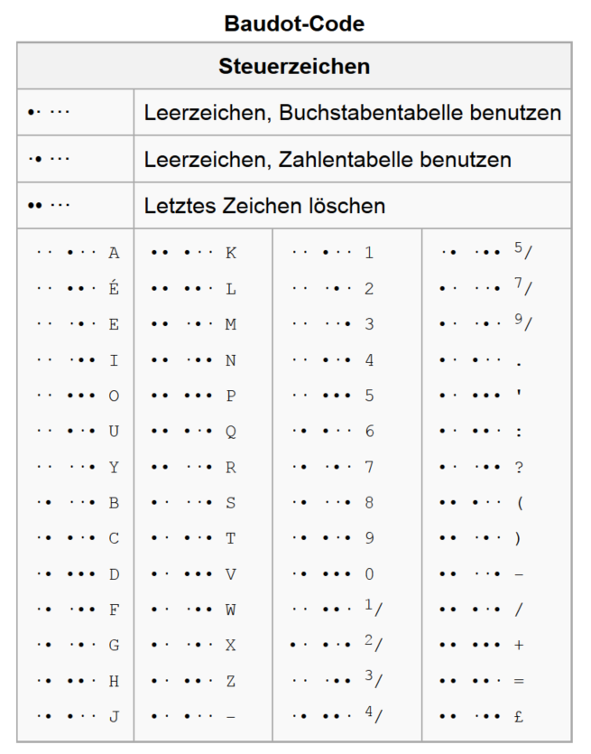
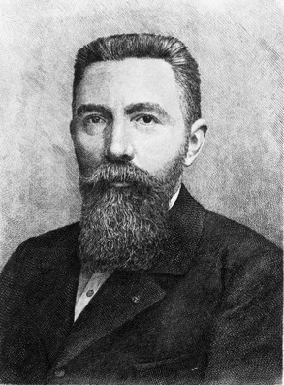
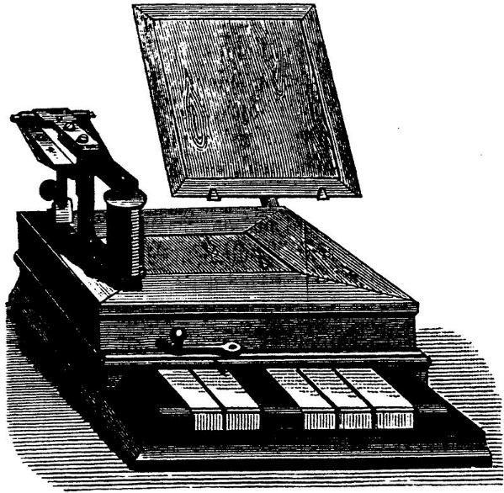
Émile Baudot invented the ASCII Code predecessor
Émile Baudot
1845 - 1903

Slide 50
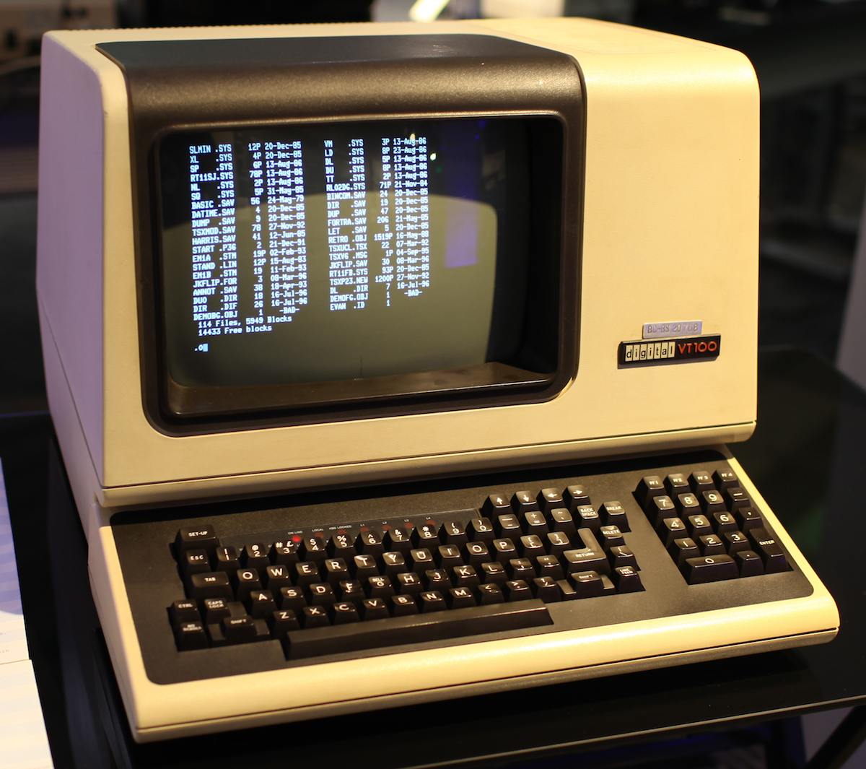
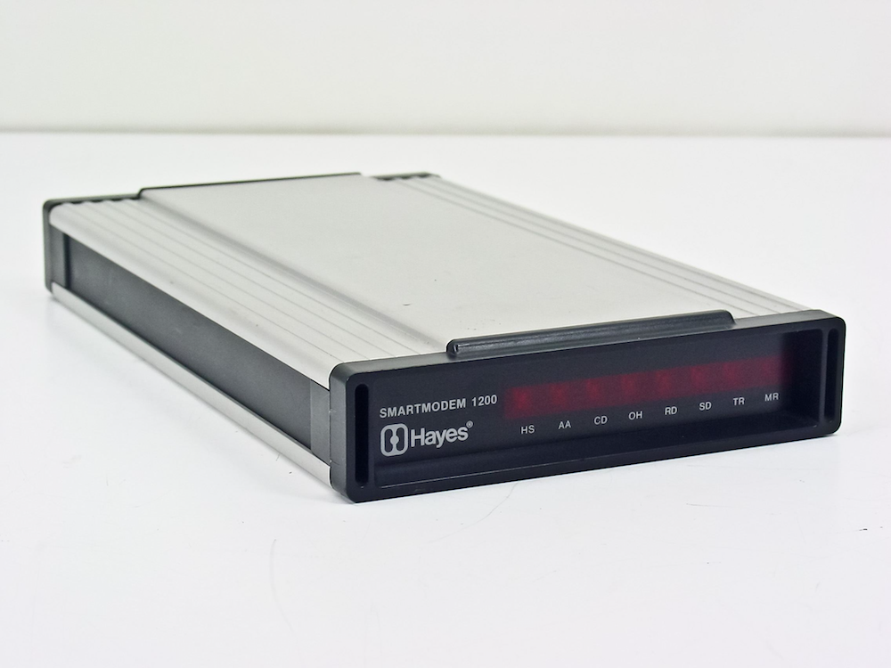
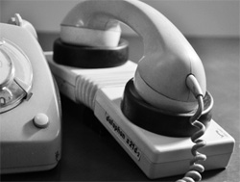
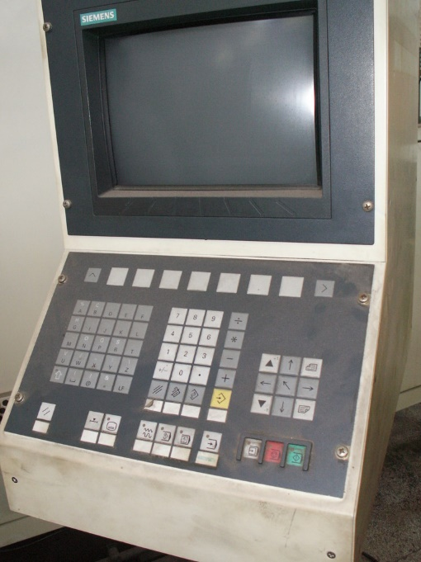
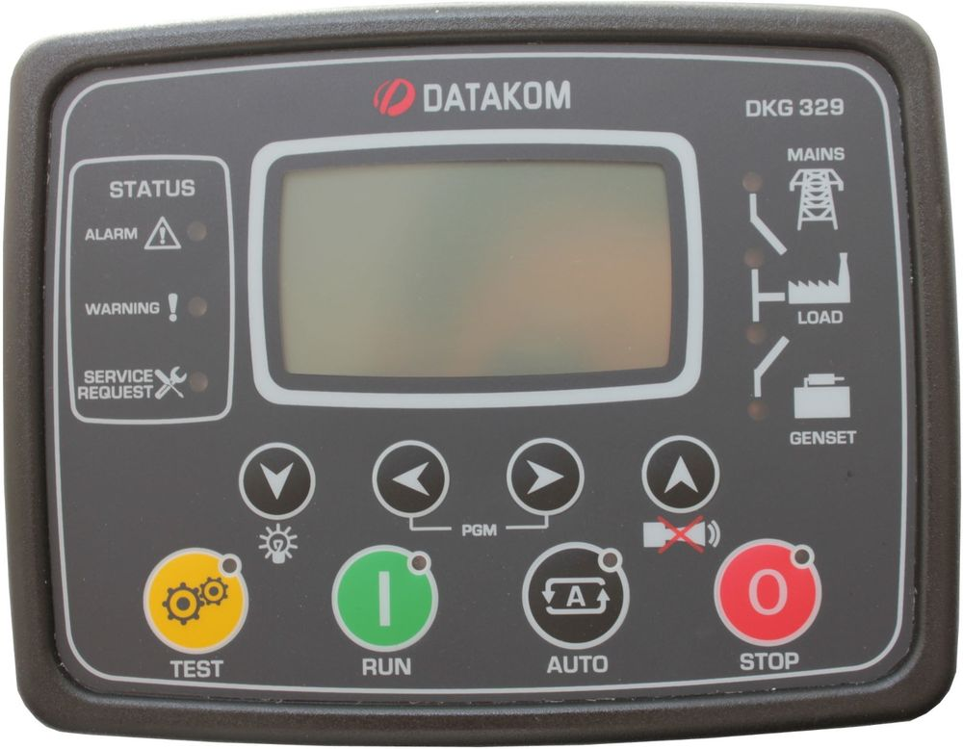
UART early Applications
1200 Baud Modem
9600 Baud Terminal
300 Baud Akustikkoppler
9600 Baud CNC Steuerung
9600 Baud Industriesteuerung

Slide 51
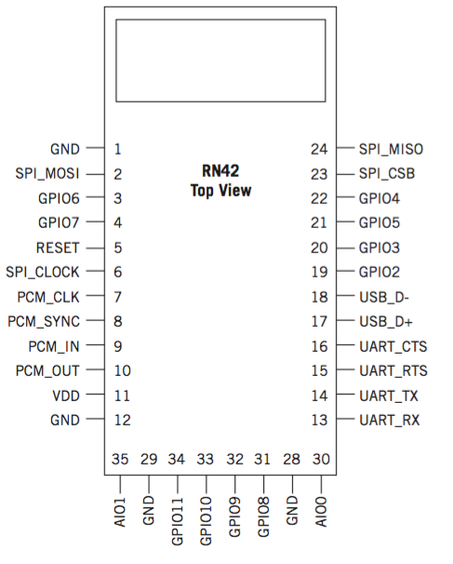
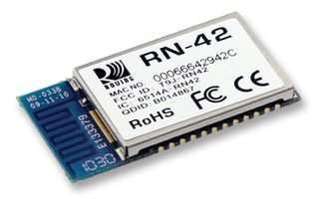
UART-IF Example : Bluetooth Module RN42
UART Port des BT Modules
CTS: Clear to Send
RTS: Ready to Send
TX: Transmit data
RX: Receive data

Slide 52
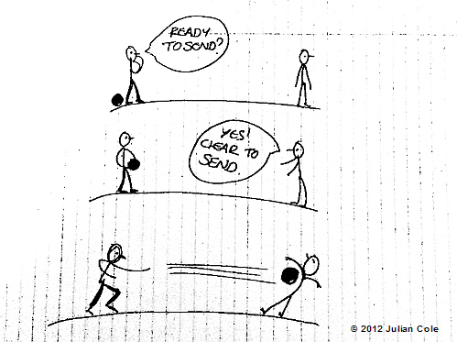

UART Hardware Handshake

Slide 53
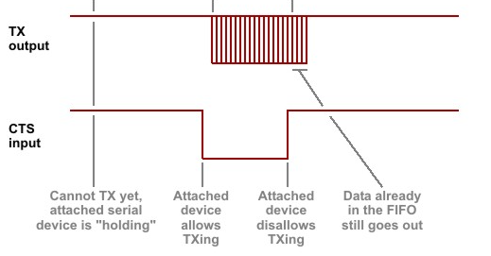
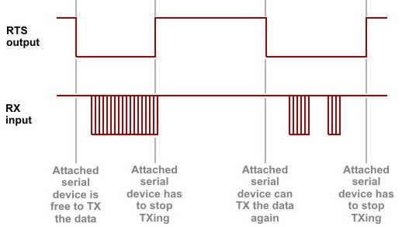
UART Hardware Handshake
Seen from the side of the Bluetooth Module
CTS Function
RTS Function (not used)

Slide 54
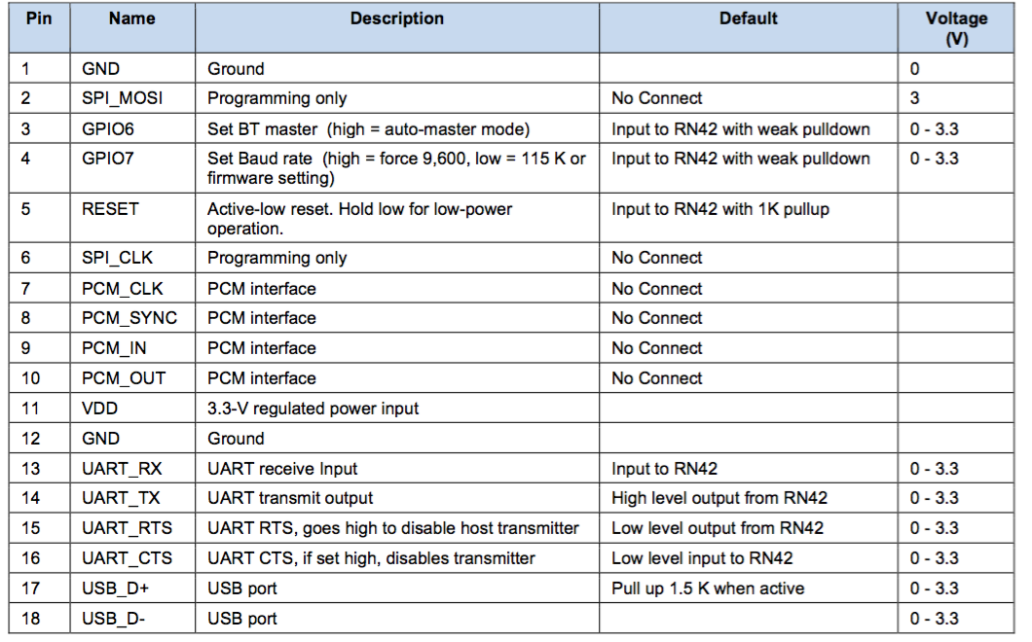
Bluetooth Module RN42

Slide 55
VHDL_02: More RTL Block Design
Laboratory
Design of a UART receiver (UART-RX) with:
Baud rate: 31250 bits per second, no parity bit
Serial input via GPIO pin in extension header of the board
Display each received byte into two seven segment displays (as two hexadecimal characters)
Check for correct values of start-bit and stop-bit

Slide 56
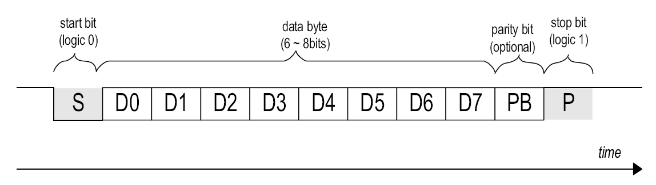
Sampling the Serial Datastream
stop bit
(logic 1)
data byte
(8 bits)
stop bit
(logic 1)
Start
Stop
baud_tick
start_bit
½ T
T
T
Bit-Count
1 2 3 4 5 6 7 8 9 10

Slide 57
Block Diagram of UAR(T) DIVIDE AND CONQUER
from GPIO
sync_n_ edge_det
RX_FSM
tick_
generator
to HEX[6..0]
RX_ registers
sev_seg decoders

